Slide 1
UNIT-3

Slide 2
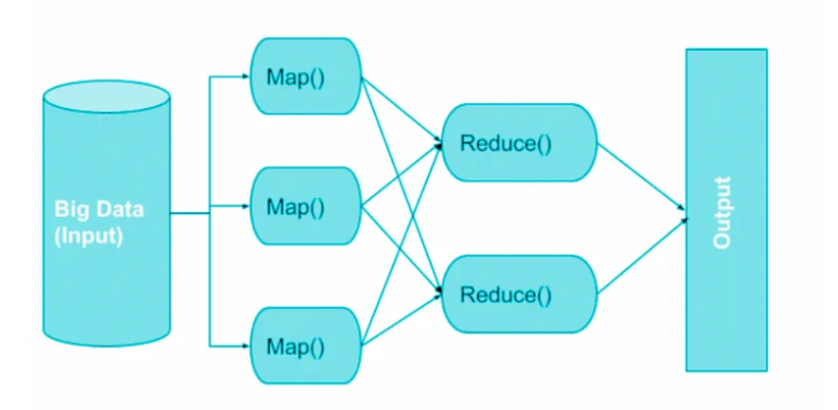
Map Reduce Operation
Every step necessitates disk reads and writes, the execution of MapReduce jobs is hindered by the inherent latency of disk I/O.

Slide 3
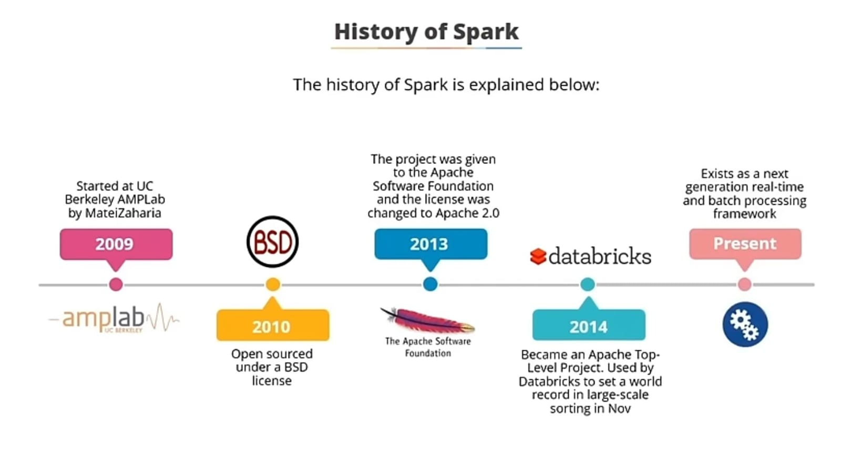

Slide 4
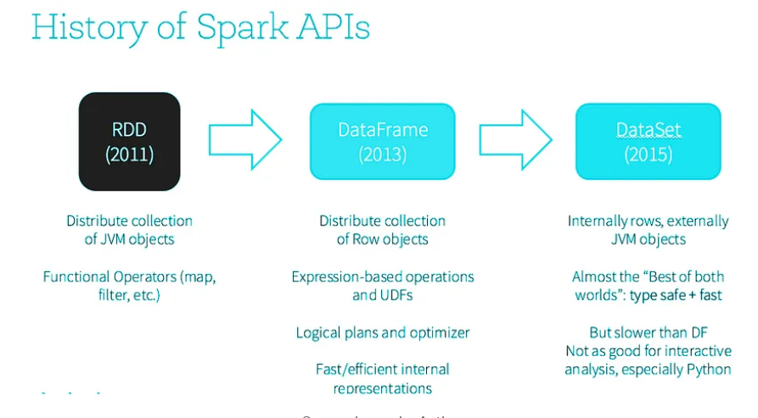

Slide 5
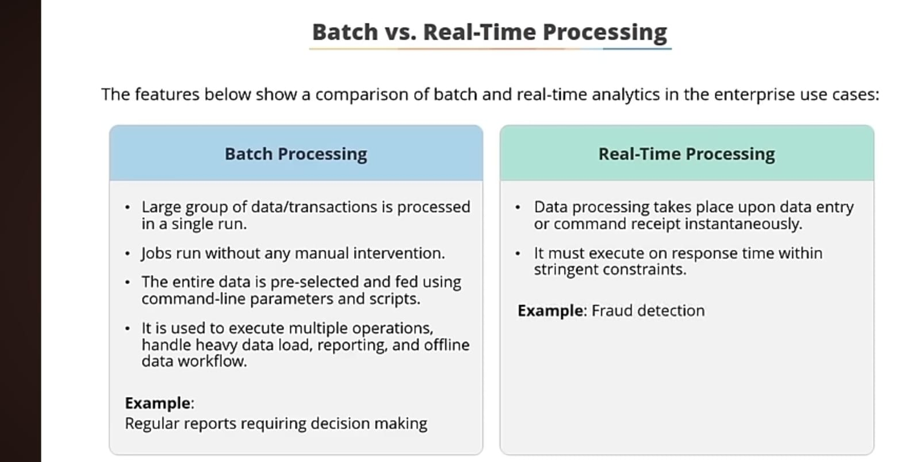

Slide 6
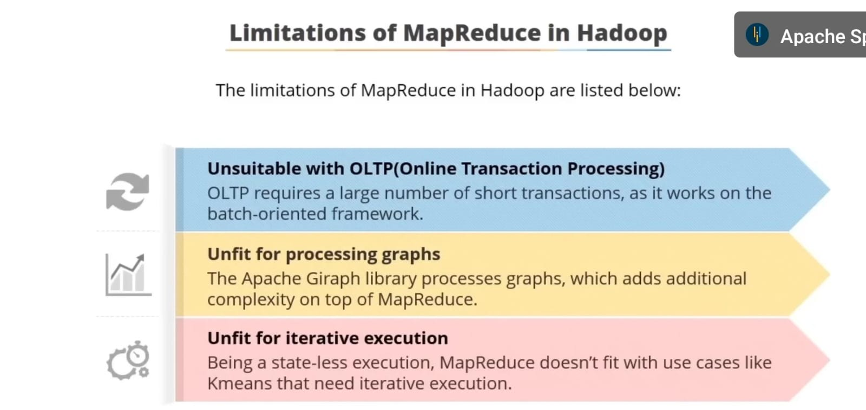

Slide 7
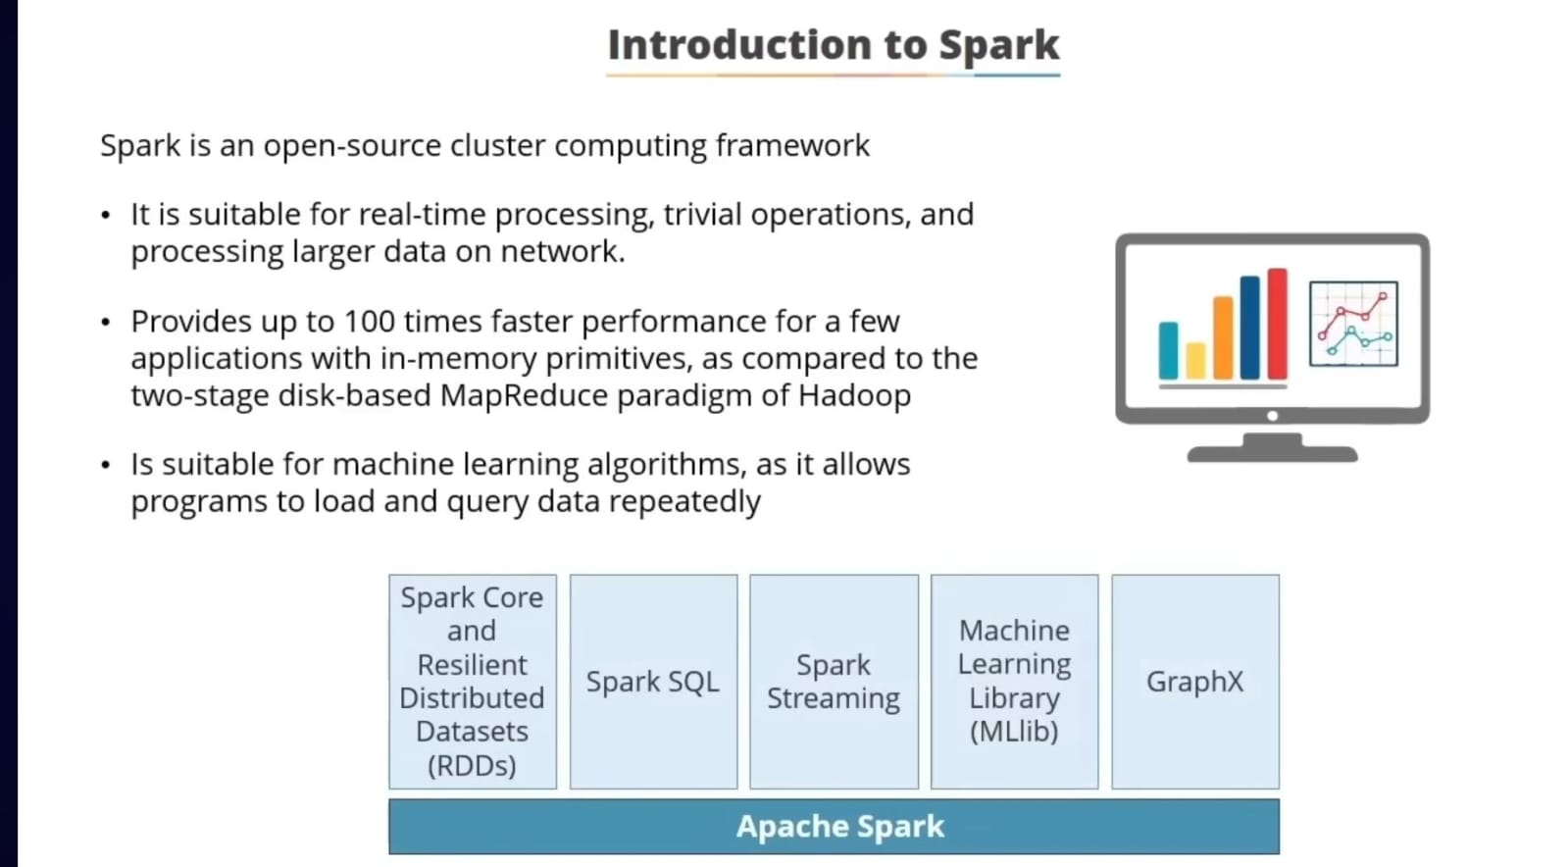

Slide 8
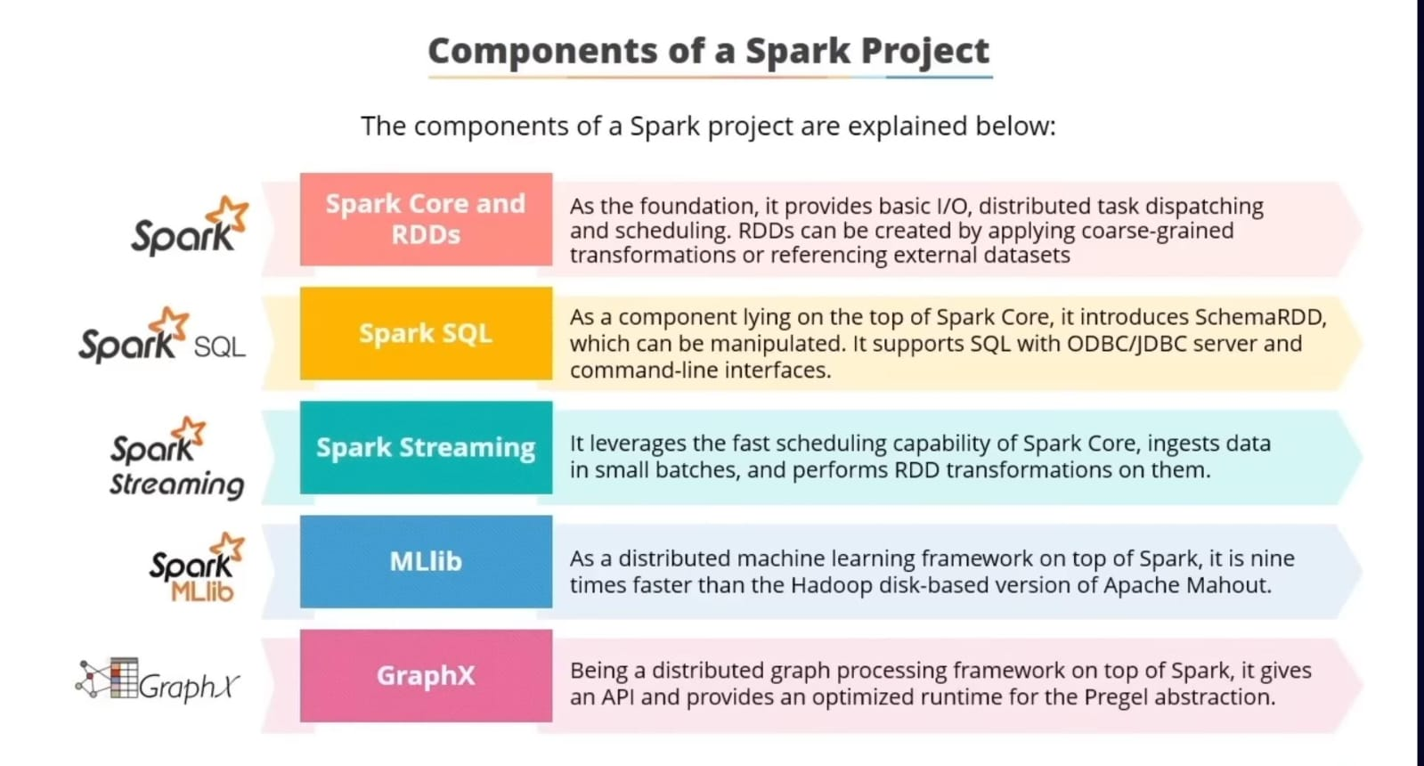

Slide 9
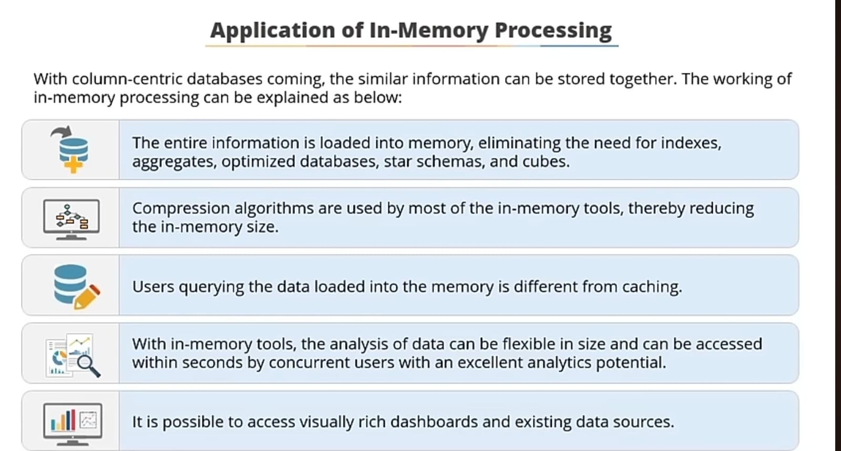

Slide 10
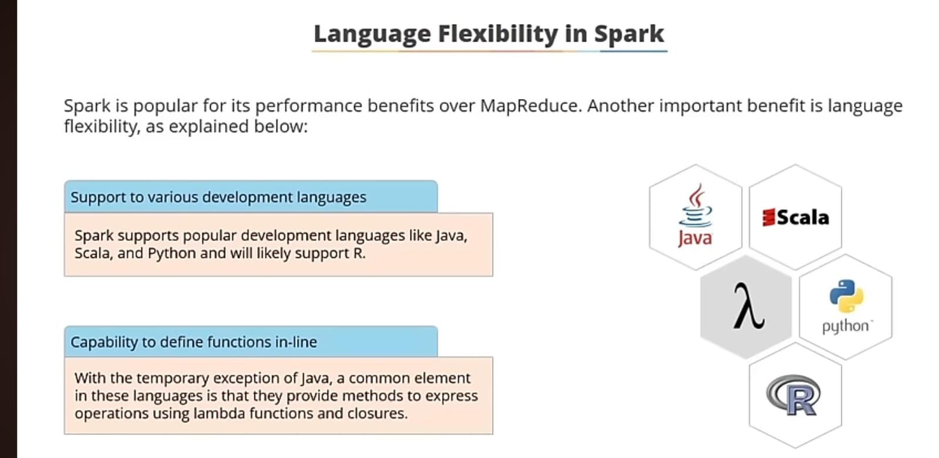

Slide 11
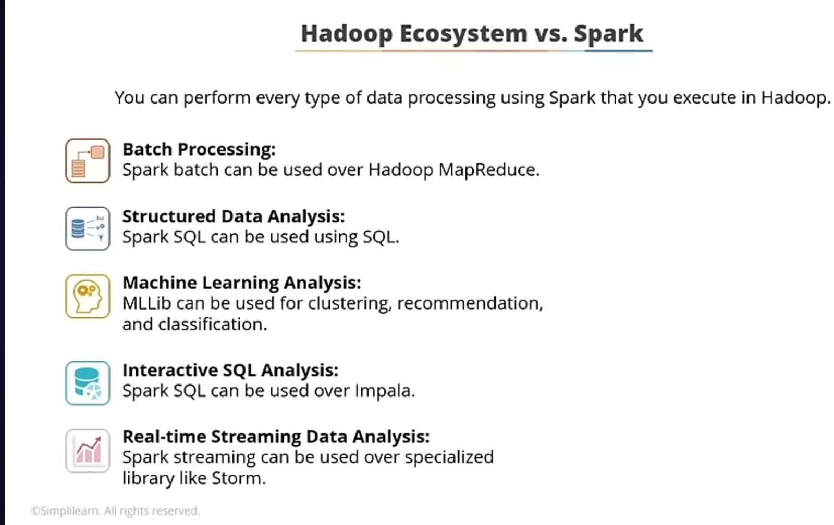

Slide 12
Your title here
Presentations are communication tools

Slide 13
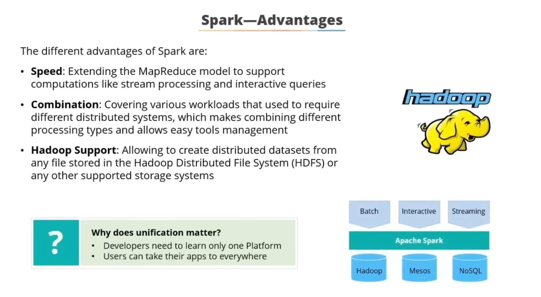

Slide 14
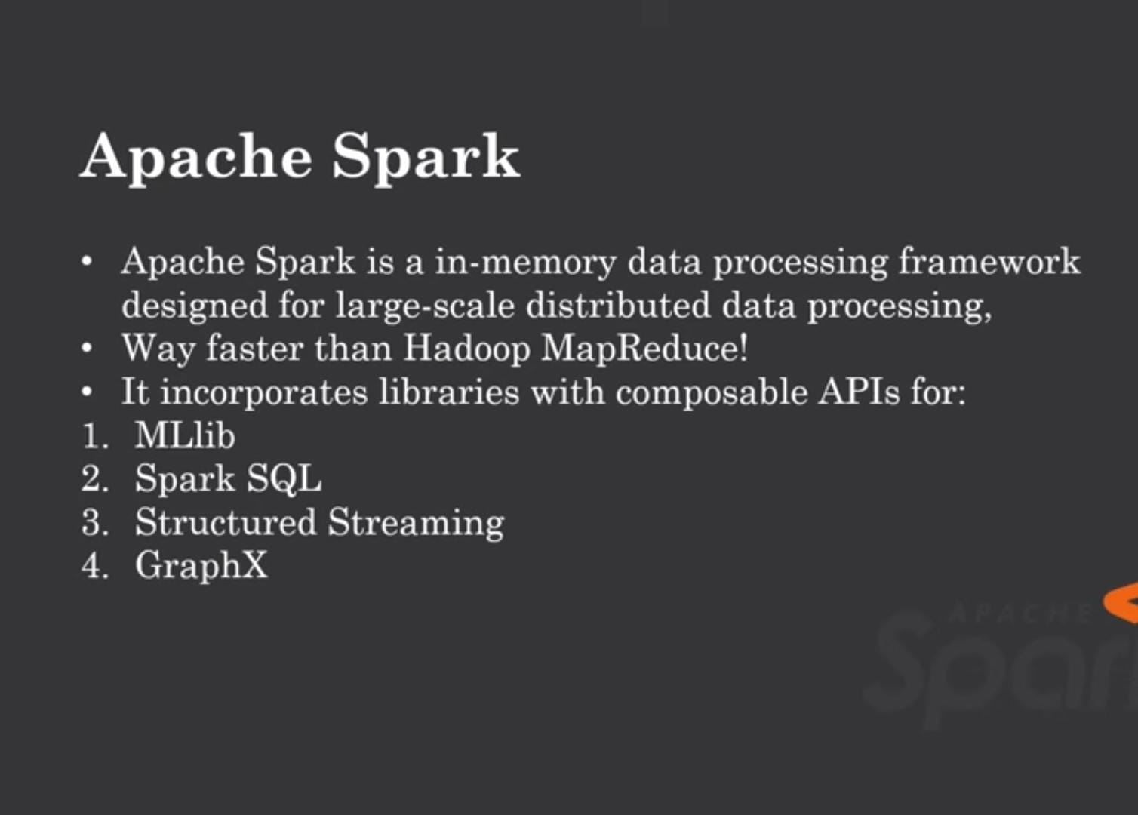

Slide 15
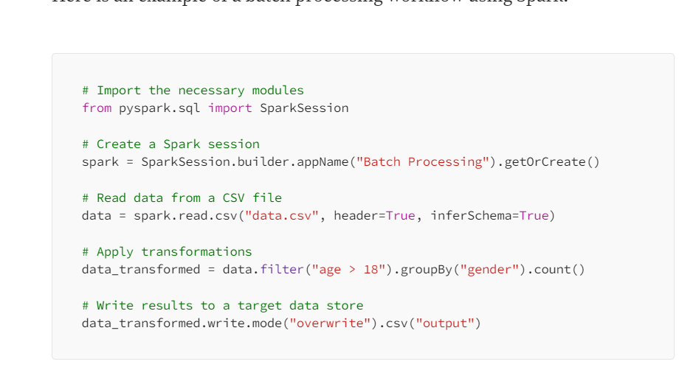
Batch Processing

Slide 16
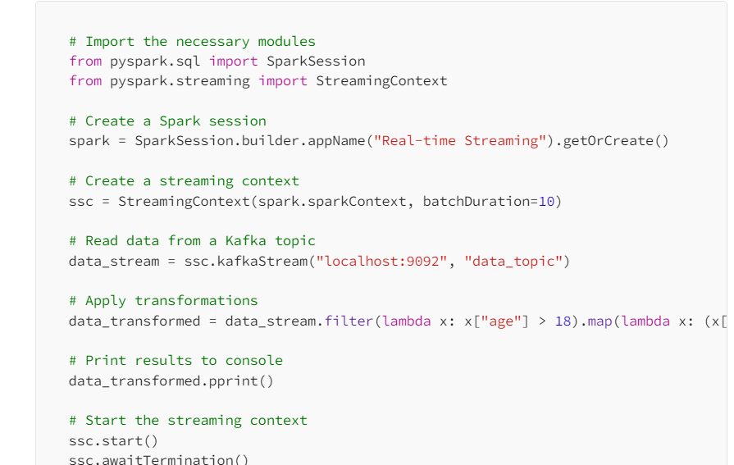
Real Time Processing

Slide 17
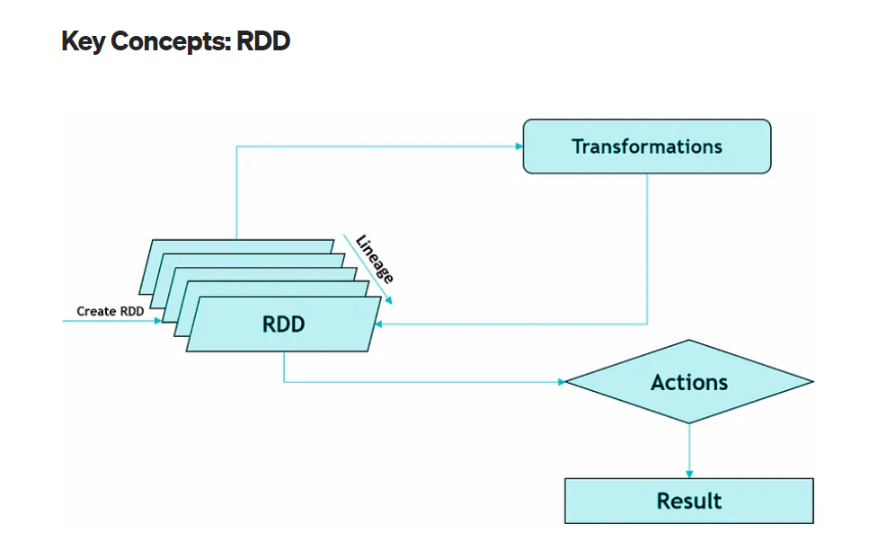

Slide 18
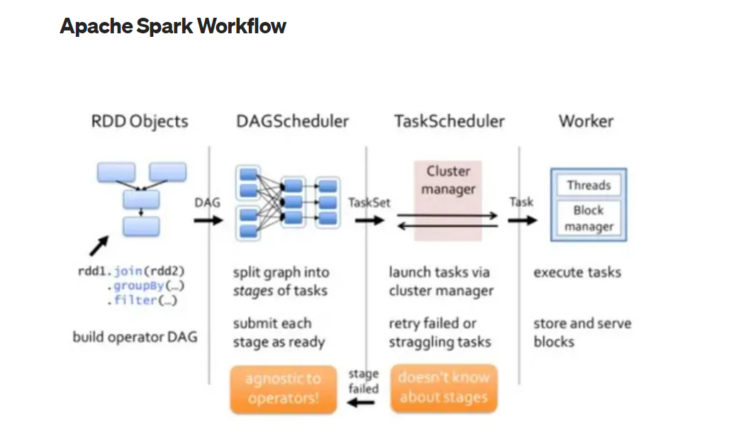

Slide 19
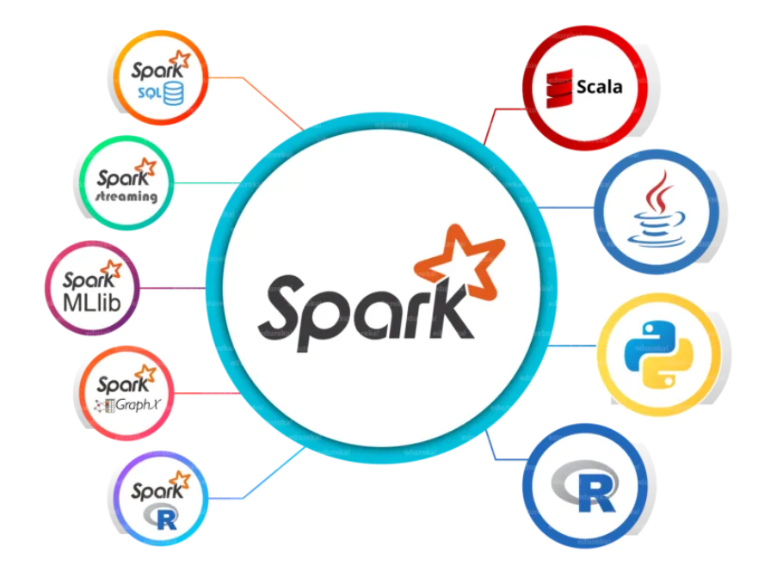
Spark Eco System

Slide 20
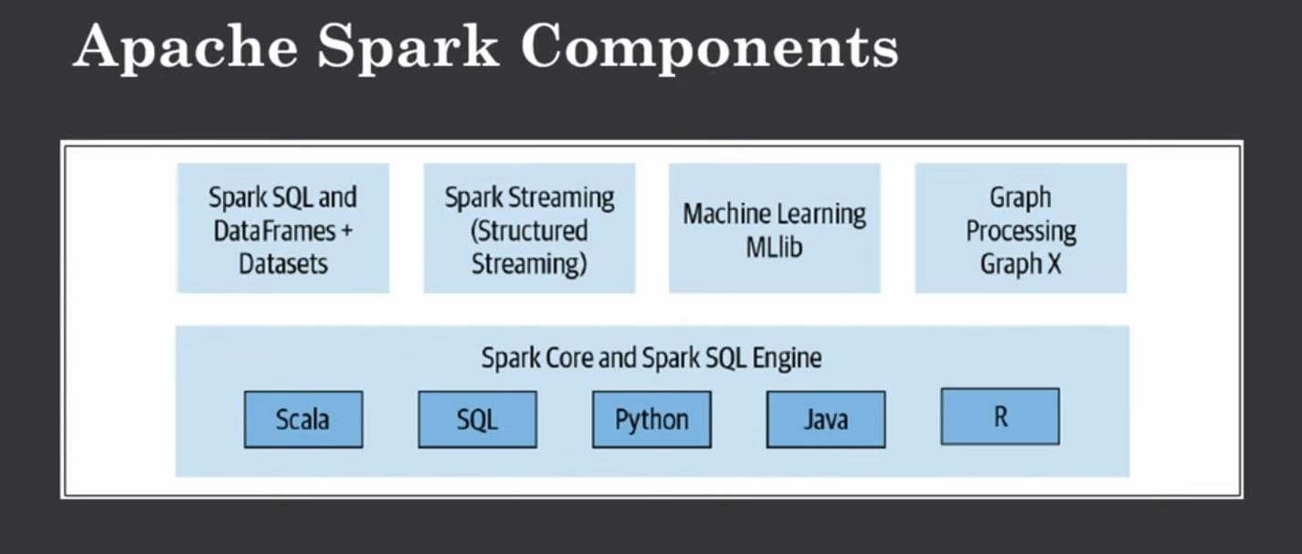

Slide 21
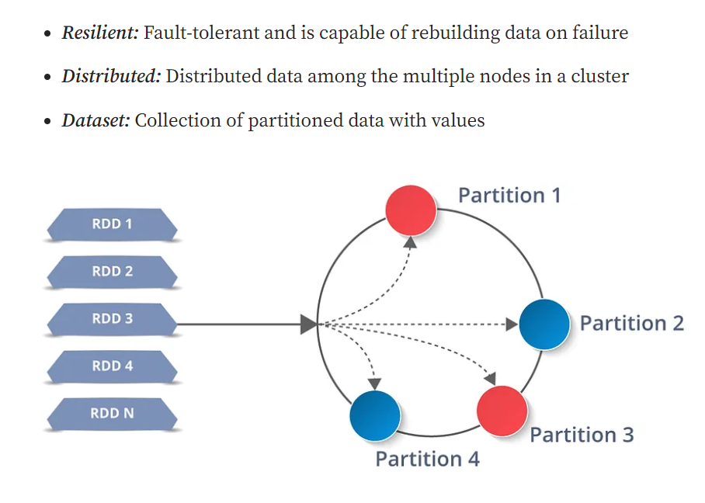
Resilient Distributed Dataset(RDD)

Slide 22
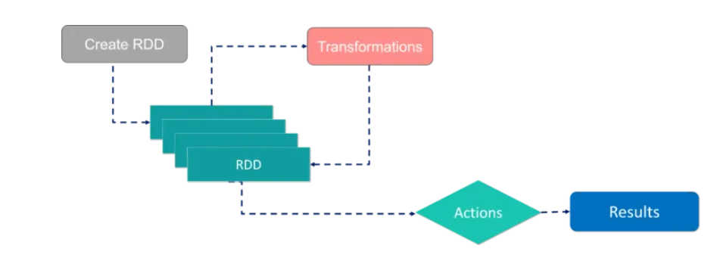
With RDDs, you can perform two types of operations: Transformations: They are the operations that are applied to create a new RDD. Actions: They are applied on an RDD to instruct Apache Spark to apply computation and pass the result back to the driver.

Slide 23
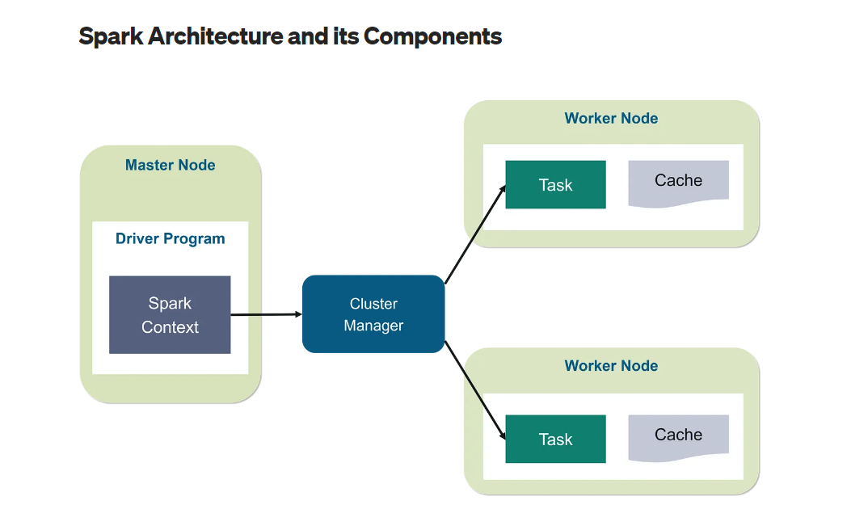

Slide 24
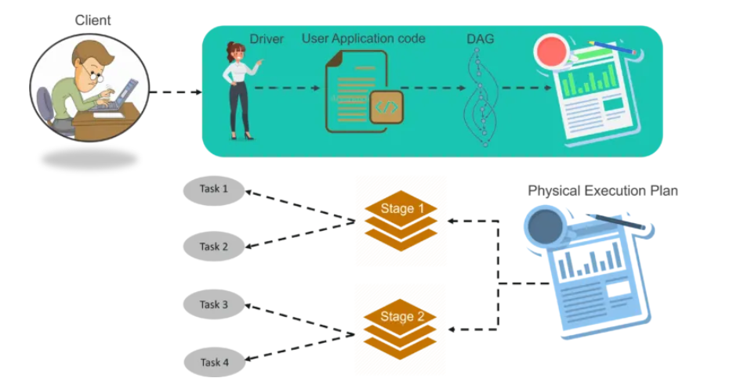

Slide 25
Refferences
https://medium.com/@DataEngineeer/introduction-to-apache-spark-for-data-engineering-d2060166165a
https://medium.com/nerd-for-tech/exploring-big-data-with-apache-spark-introduction-and-key-components-a6872c581ce6

Slide 26
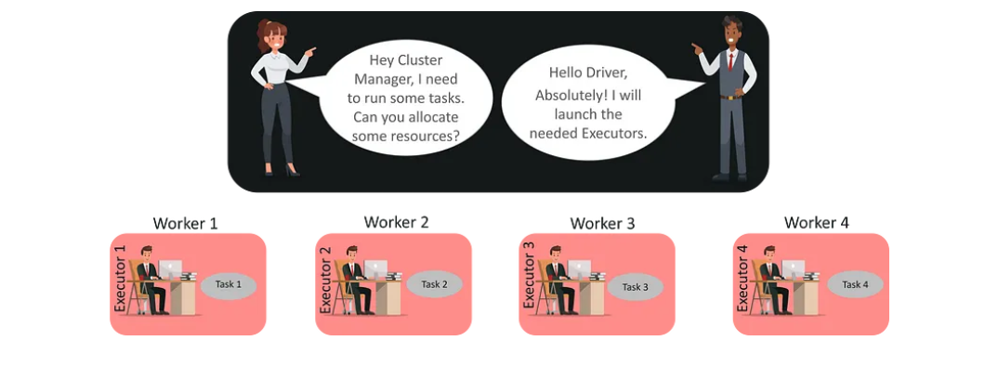

Slide 27
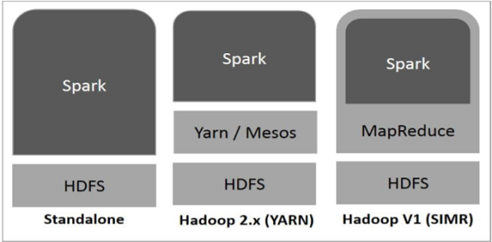
Spark Built on Hadoop

Slide 28
Spark Resources
https://www.tutorialspoint.com/apache_spark/apache_spark_useful_resources.htm

Slide 29
Scala Fundamentals
Scala combines object-oriented and functional programming in one concise, high-level language.
Scala's static types help avoid bugs in complex applications, and its JVM and JavaScript runtimes let you build high-performance systems with easy access to huge ecosystems of libraries.

Slide 30
Stuctured API’s
These APIs refer to three core types of distributed collection
APIs:
Datasets
DataFrames
SQL tables and views

Slide 31
DataFrames and Datasets
Spark has two notions of structured collections: DataFrames and
Datasets.
To Spark, DataFrames and Datasets represent immutable, lazily evaluated plans that specify what operations to apply to data residing at a location to generate some output.
When we perform an action on a DataFrame, we instruct Spark to perform the actual transformations and return the result.

Slide 32
Functional programming
Functional programming is a programming paradigm that prioritises using pure functions and immutable data. Unlike imperative programming, which is based on modifying the state of variables, available programming focuses on composing functions that transform data. This approach brings several benefits, including improved code maintainability, testability, and concurrency.

Slide 33
Features
Absolute Essentials Defining values (val) Inference,recursion
Object-Oriented Programming (Hof )
Pattern Matching
Advanced Functional Programming
Reference : https://www.tutorialspoint.com/scala/scala_basic_syntax.htm
https://docs.scala-lang.org/tour/basics.html

Slide 34
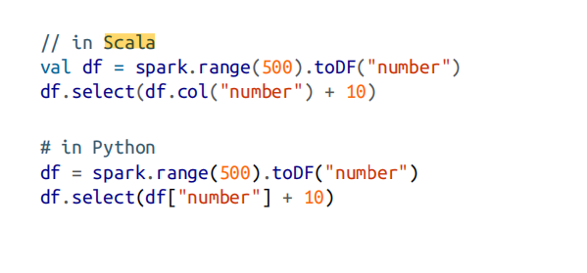
Schemas
A schema defines the column names and types of a DataFrame. You can define schemas manually or read a schema from a data source (often called schema on read).
Overview of Structured Spark Types
Spark is effectively a programming language of its own. Internally, Spark uses an engine called Catalyst that maintains its own type information through the planning and processing of work.

Slide 35
DataFrames Versus Datasets
Structured APIs, there are two more APIs, the “untyped” DataFrames and the “typed” Datasets.
To say that DataFrames are untyped is aslightly inaccurate; they havetypes, but Spark maintains them completely and only checks whether those types line up to those specified in the schema at runtime.
Datasets, on the other hand, check whether types conform to the specification at compile time. Datasets are only available to Java Virtual Machine (JVM)– based languages (Scala and Java) and we specify types with case classes or Java beans.

Slide 36
Overview of Structured API Execution
Here’s an overview of the steps:
1. Write DataFrame/Dataset/SQL Code.
2. If valid code, Spark converts this to a Logical Plan.
3. Spark transforms this Logical Plan to a Physical Plan, checking for optimizations along the way.
4. Spark then executes this Physical Plan (RDD manipulations) on the cluster.

